Slide 1
UNIT III VHF, UHF AND Microwave Antennas - II
P.RAJESH
Dept of ECE
JNTUA CE Anantapur

Slide 2
Concepts
Microstrip Antennas - Introduction, Features, Advantages and Limitations, Rectangular Patch Antennas - Geometry and Parameters, Characteristics of Microstrip Antennas.
Impact of Different Parameters on Characteristics, Reflector Antennas - Introduction, Flar Sheet and Corner Reflectors, Paraboloidal Reflectors - Geometry, Pattern Characteristics, Feed Methods, Reflector Types - Related Features, Illustrative Problems.
Lens Antennas - Introduction, Geometry of Non-metallic Dielectric Lenses, Zoning, Tolerances, Applications

Slide 3
Introduction
VHF, UHF and SHF antennas which are operating between the frequency range of 30 to 300 MHz , 300 to 3000 Mhz and 3000 to 30000 Mhz respectively.
The corresponding Wavelengths of these antennas are 10 to 1 meter, 1 to 0.1meter(or 100 cm to 10 cm) and 10cm to 1 cm.
Antennas operating above the frequency 2000 Mhz are often called as Micro-Wave antennas.
Elevated Wires and Tubing rods of Aluminum or copper is used in VHF and UHF bands and besides these arrays VHF and UHF antenns are also used to increase Directivity.

Slide 4
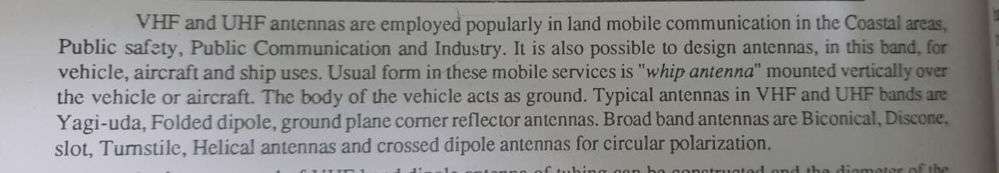

Slide 5
Introduction
The antennas operating in frequency range (3000-30000 Mhz) are called SHF(Super High Frequency) Antenna.
Typically antennas used in SHF range are Parabolic Reflectors, Horn Antennas, Lens Antennas.
In SHF Antennas, the Wavelength approaches the centimeter range. Hence it is possible to construct the antenna of dimension having large number of wavelengths.
This Centimeter waveguide radiates power and forces the radiation in narrow beams.
In SHF band, Aperture antenna are employed which are physically bulky at the longer wavelengths. By Aperture we mean the plane area where from radiation is finally radiated.

Slide 6
When Centimeter waves are in use the feed form the transmitter to the antennas as is often through the waveguides rather than coaxial line.
The typical antennas of this band are parabolic, horn, and Lens antennas.

Slide 7
Babinet’s Principle and Complementary Antennas
Determines the relation between Wire antennas and aperture antenna which is introduced by babinet’s Principle of Optics.
The Babinet’s (Ba-bi-nay’s) in Optics states that when the field behind a screen with a opening is added to the field of a complementary structure, the sum is equal to the field when there is no screen.
An Extension of Babinet’s Principle which induces polarization and the more practical conducting screens was introduced by Booker.
S
(Source)
S1
(Screen)
S2
(Screen)

Slide 8
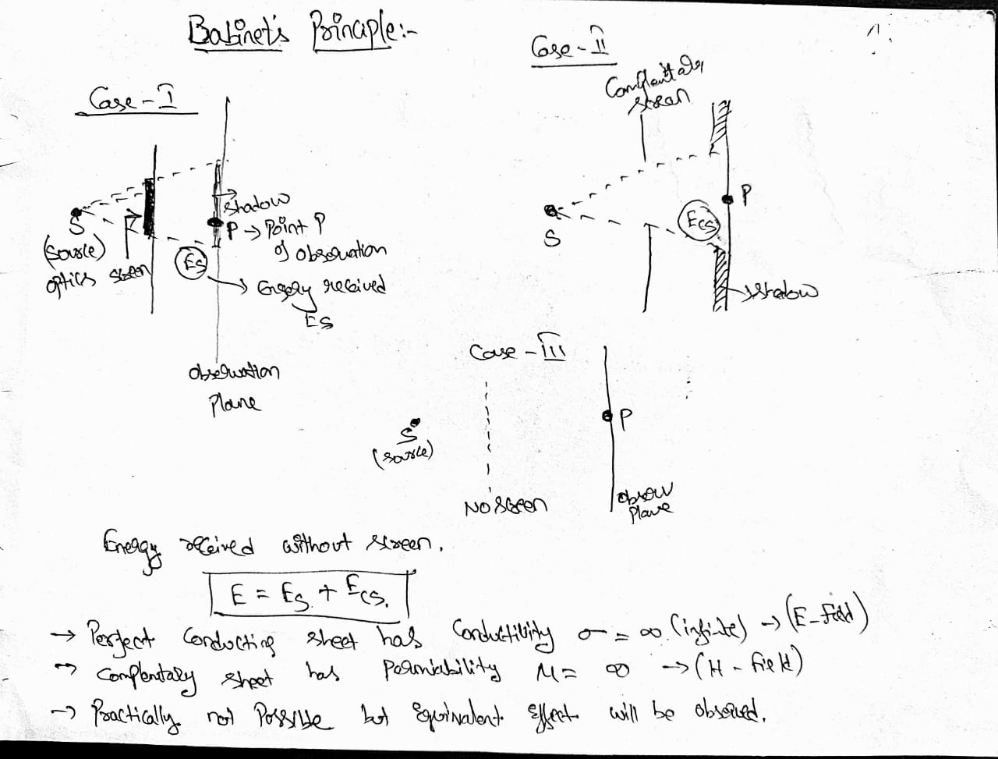

Slide 9
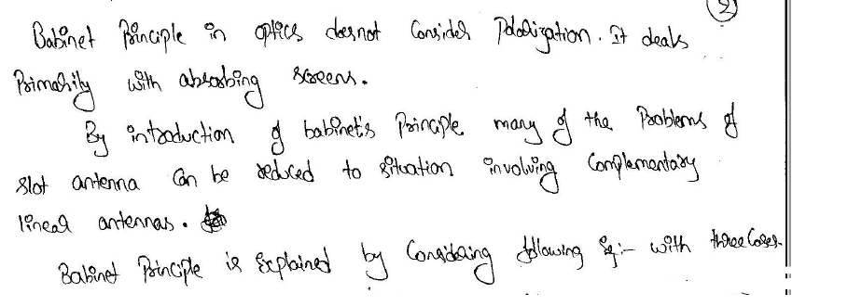

Slide 10
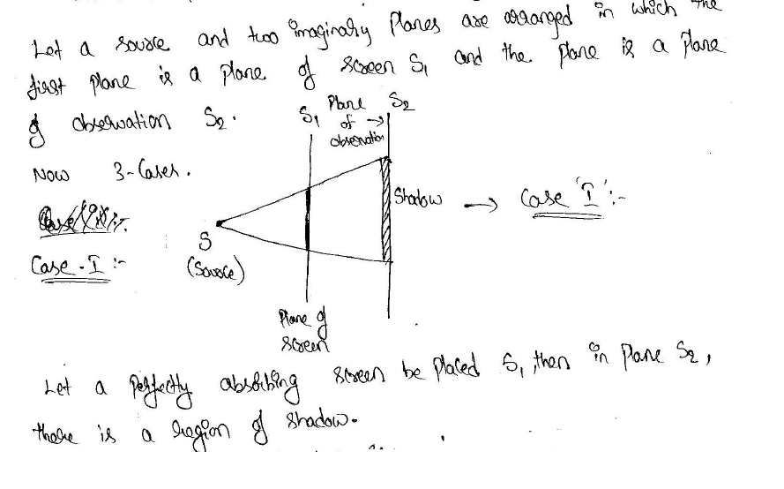
Z
x
Y

Slide 11
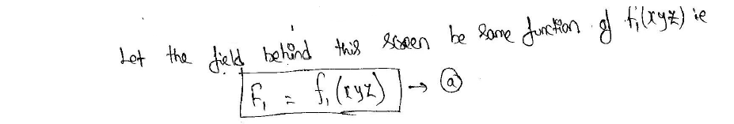
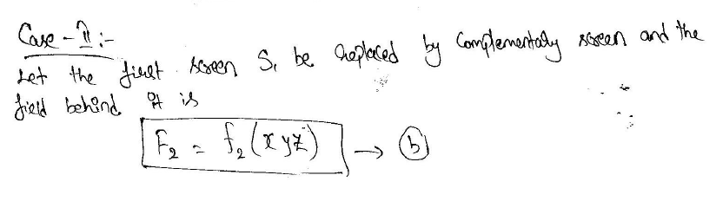
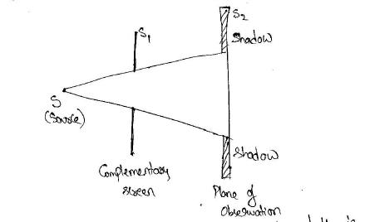

Slide 12
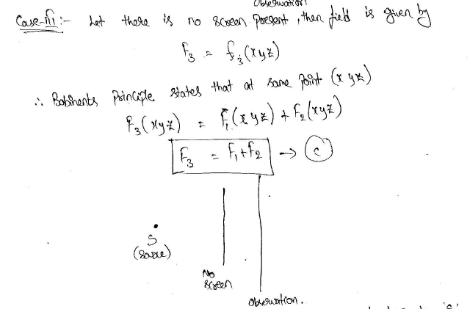

Slide 13
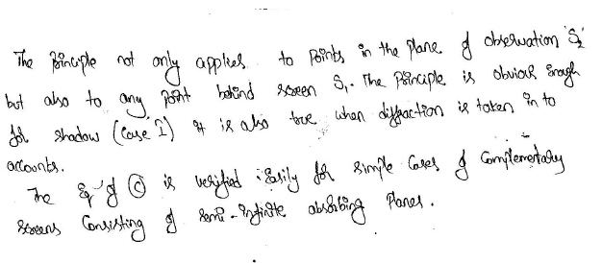

Slide 14
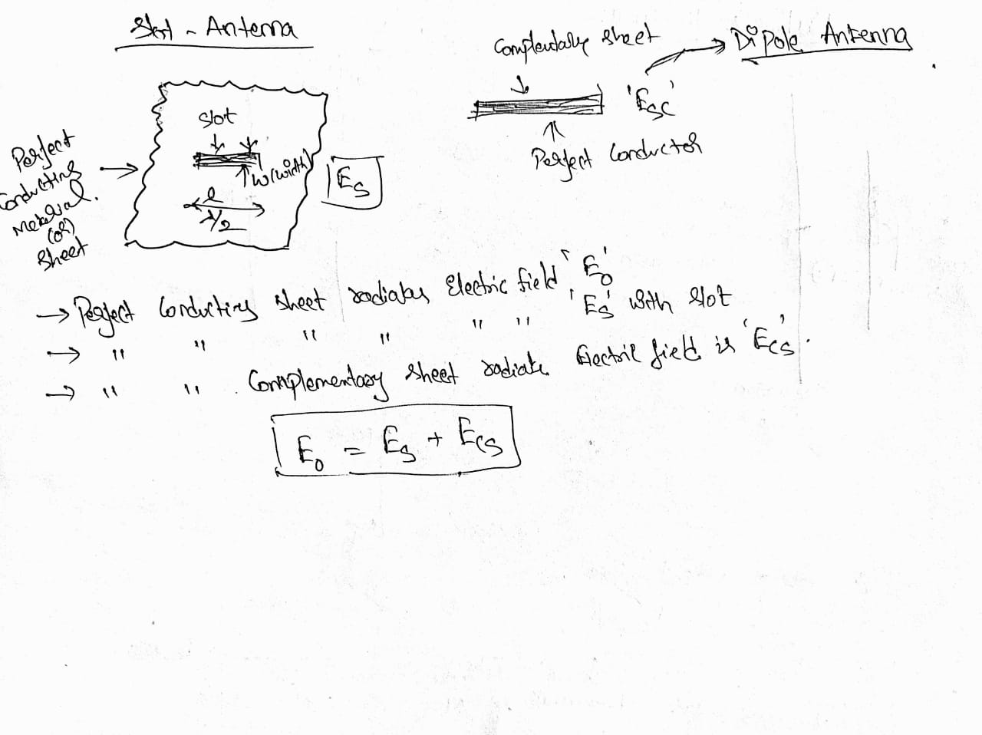
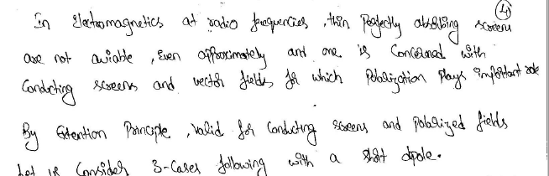

Slide 15
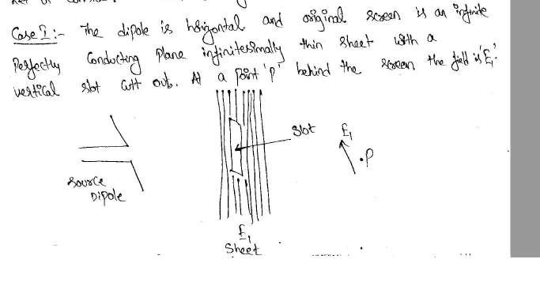

Slide 16
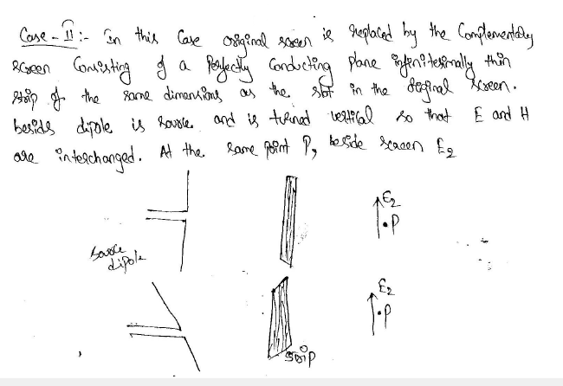

Slide 17
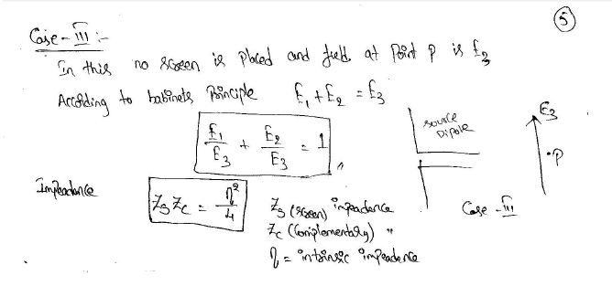

Slide 18
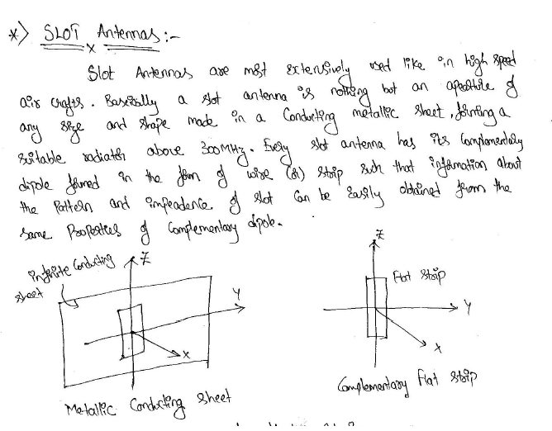

Slide 19
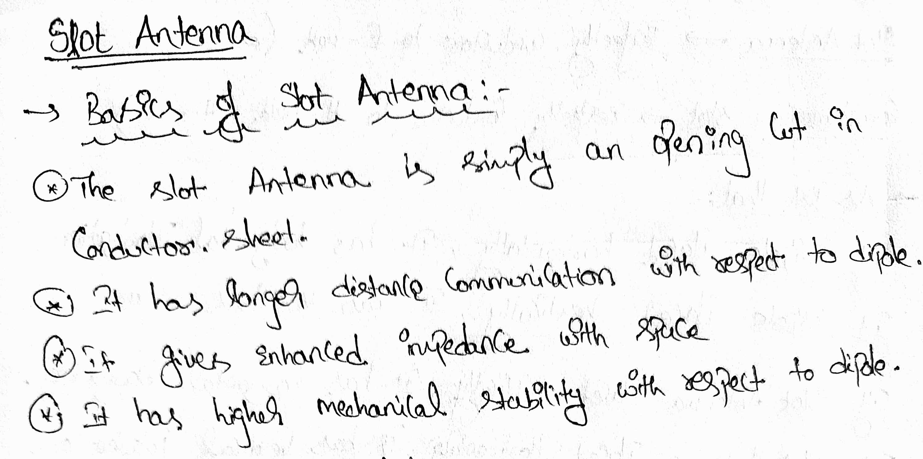

Slide 20
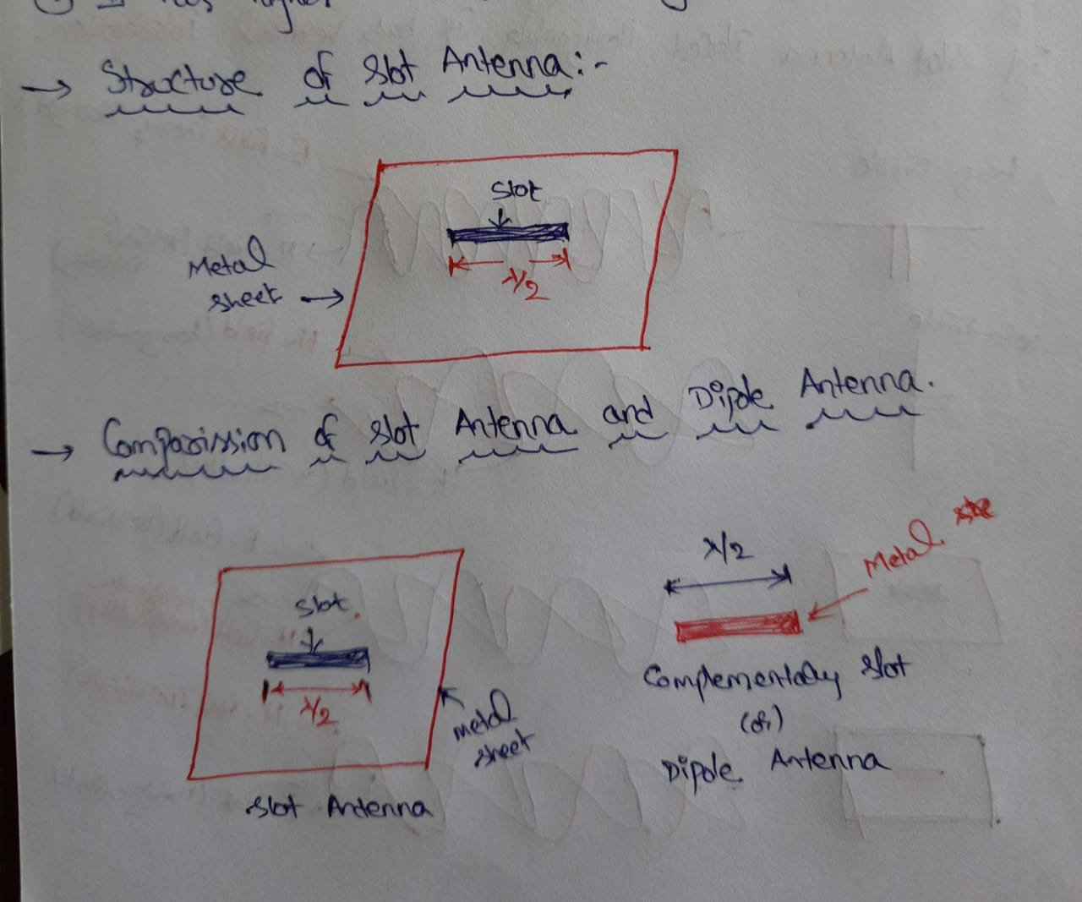

Slide 21
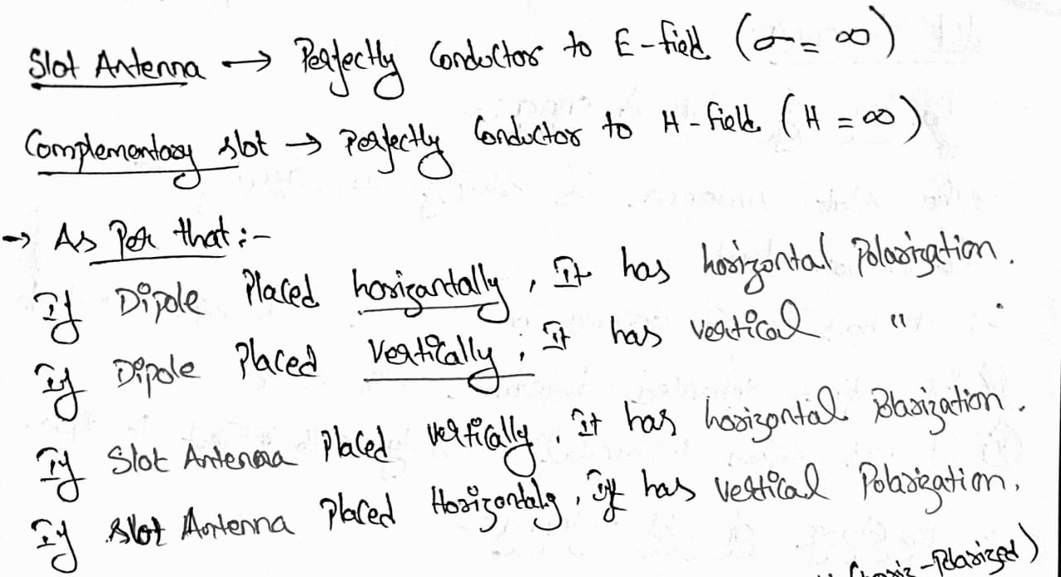

Slide 22
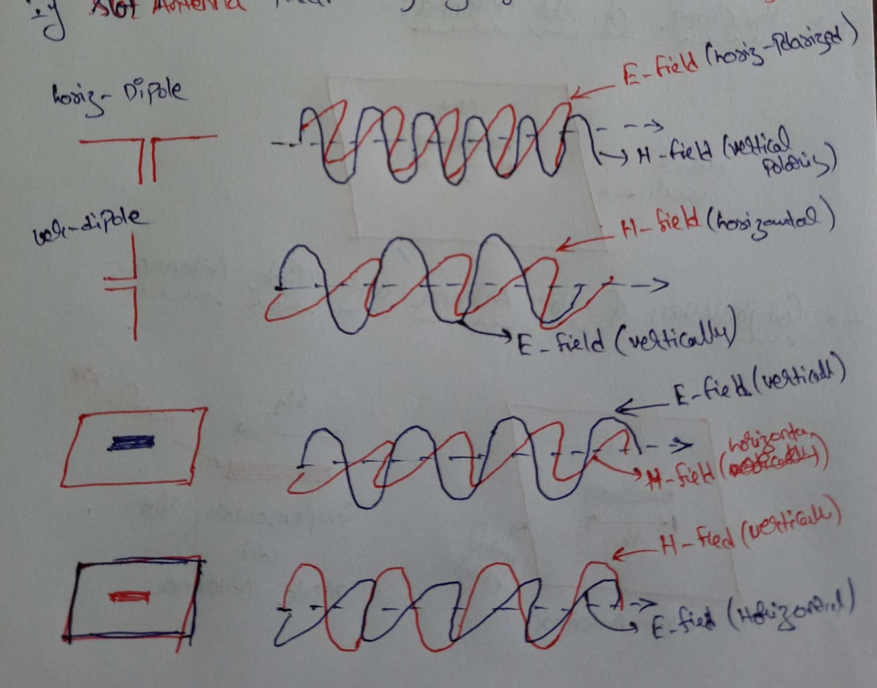

Slide 23
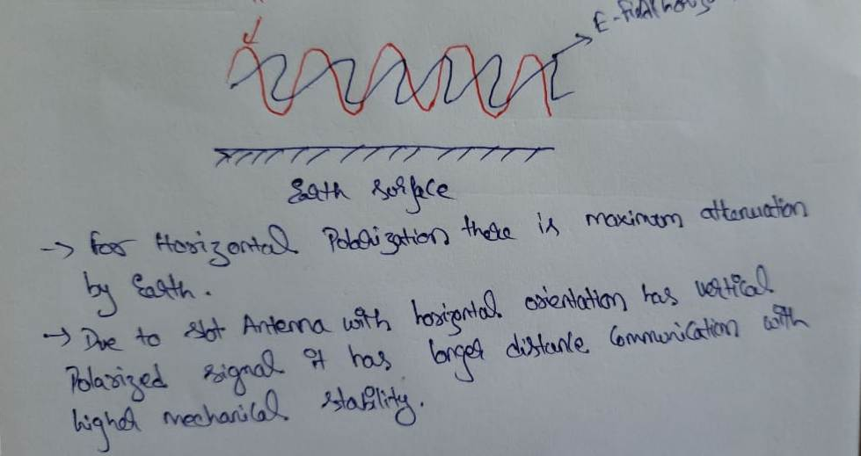

Slide 24
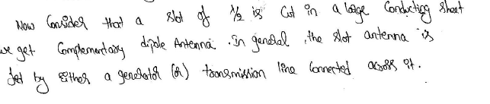
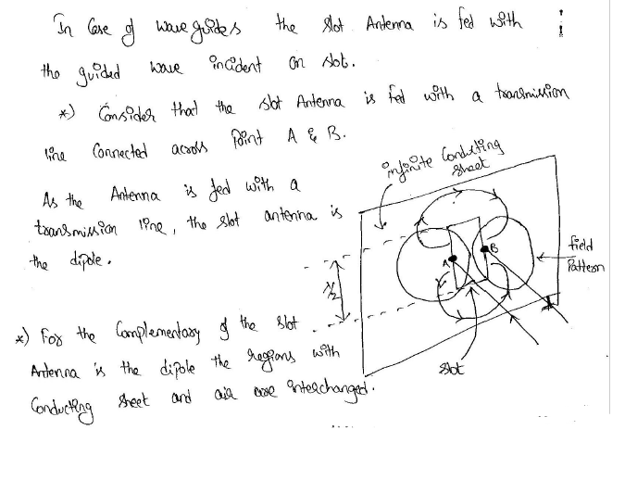

Slide 25
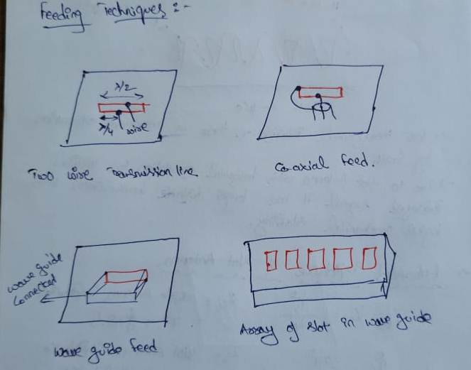

Slide 26
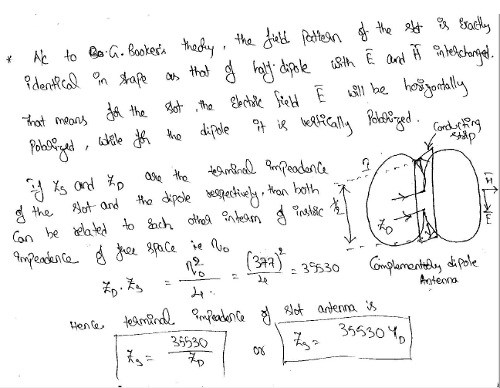

Slide 27
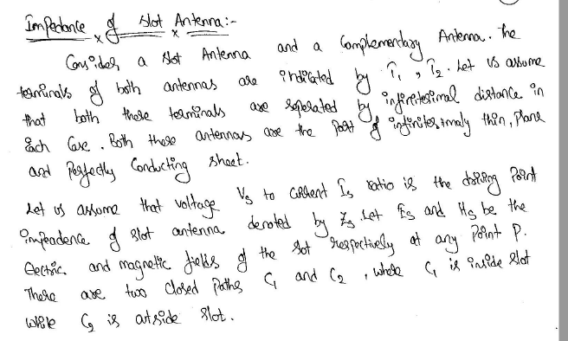

Slide 28
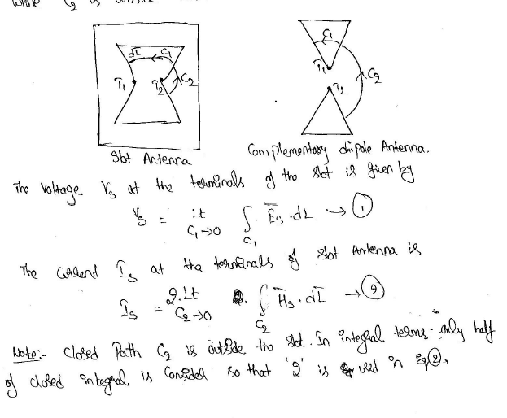

Slide 29
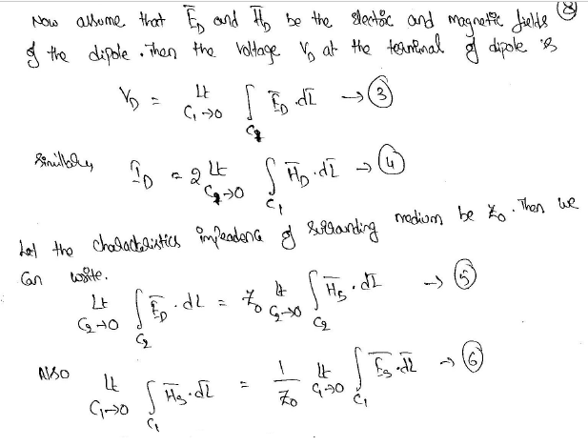

Slide 30
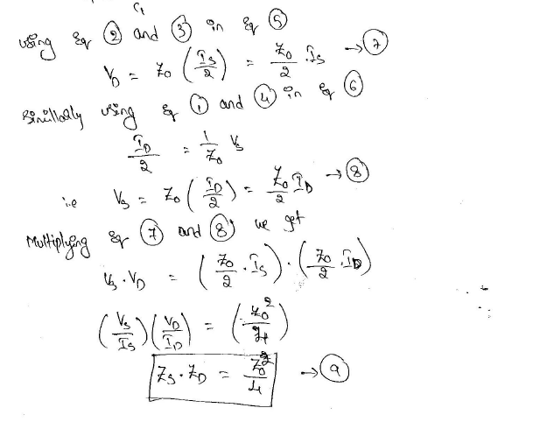

Slide 31
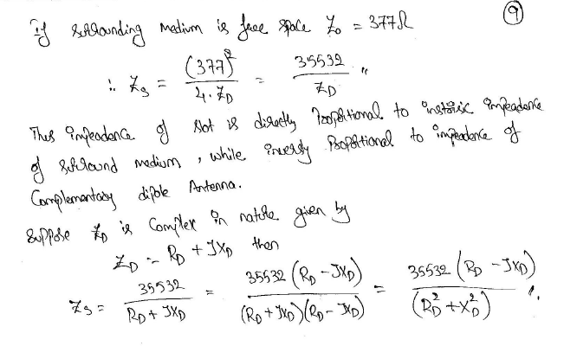

Slide 32
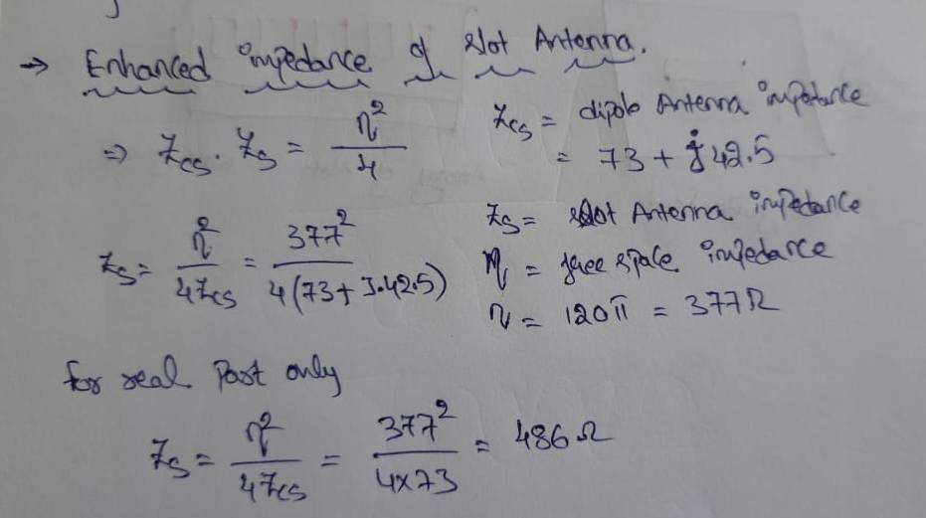

Slide 33
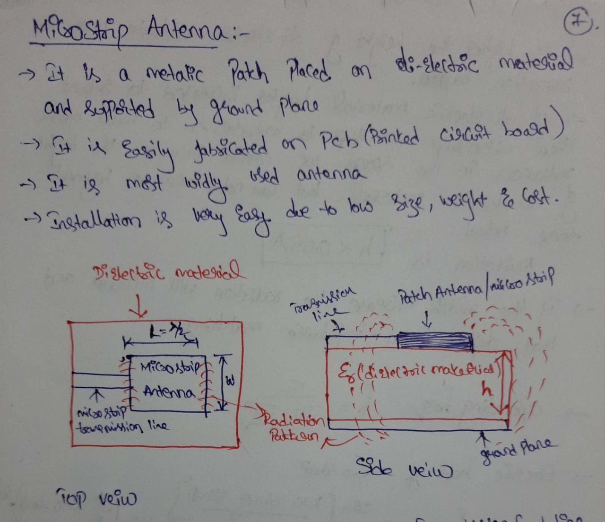

Slide 34
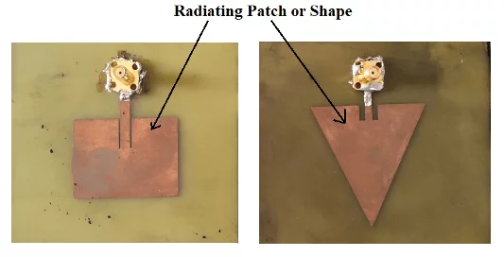
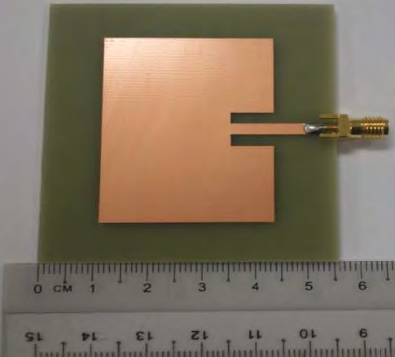
Micro Strip Antenna

Slide 35
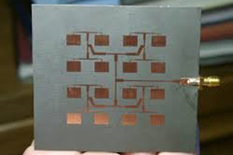
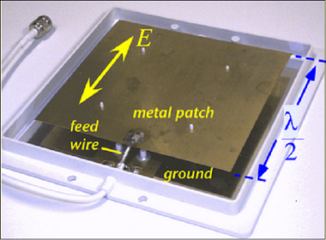

Slide 36
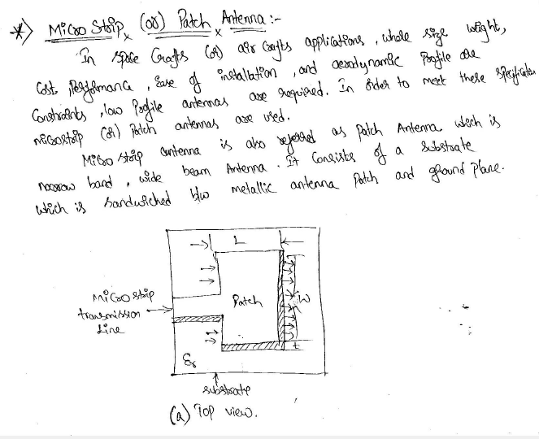
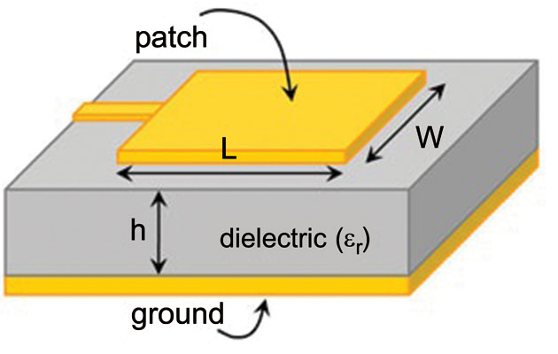

Slide 37
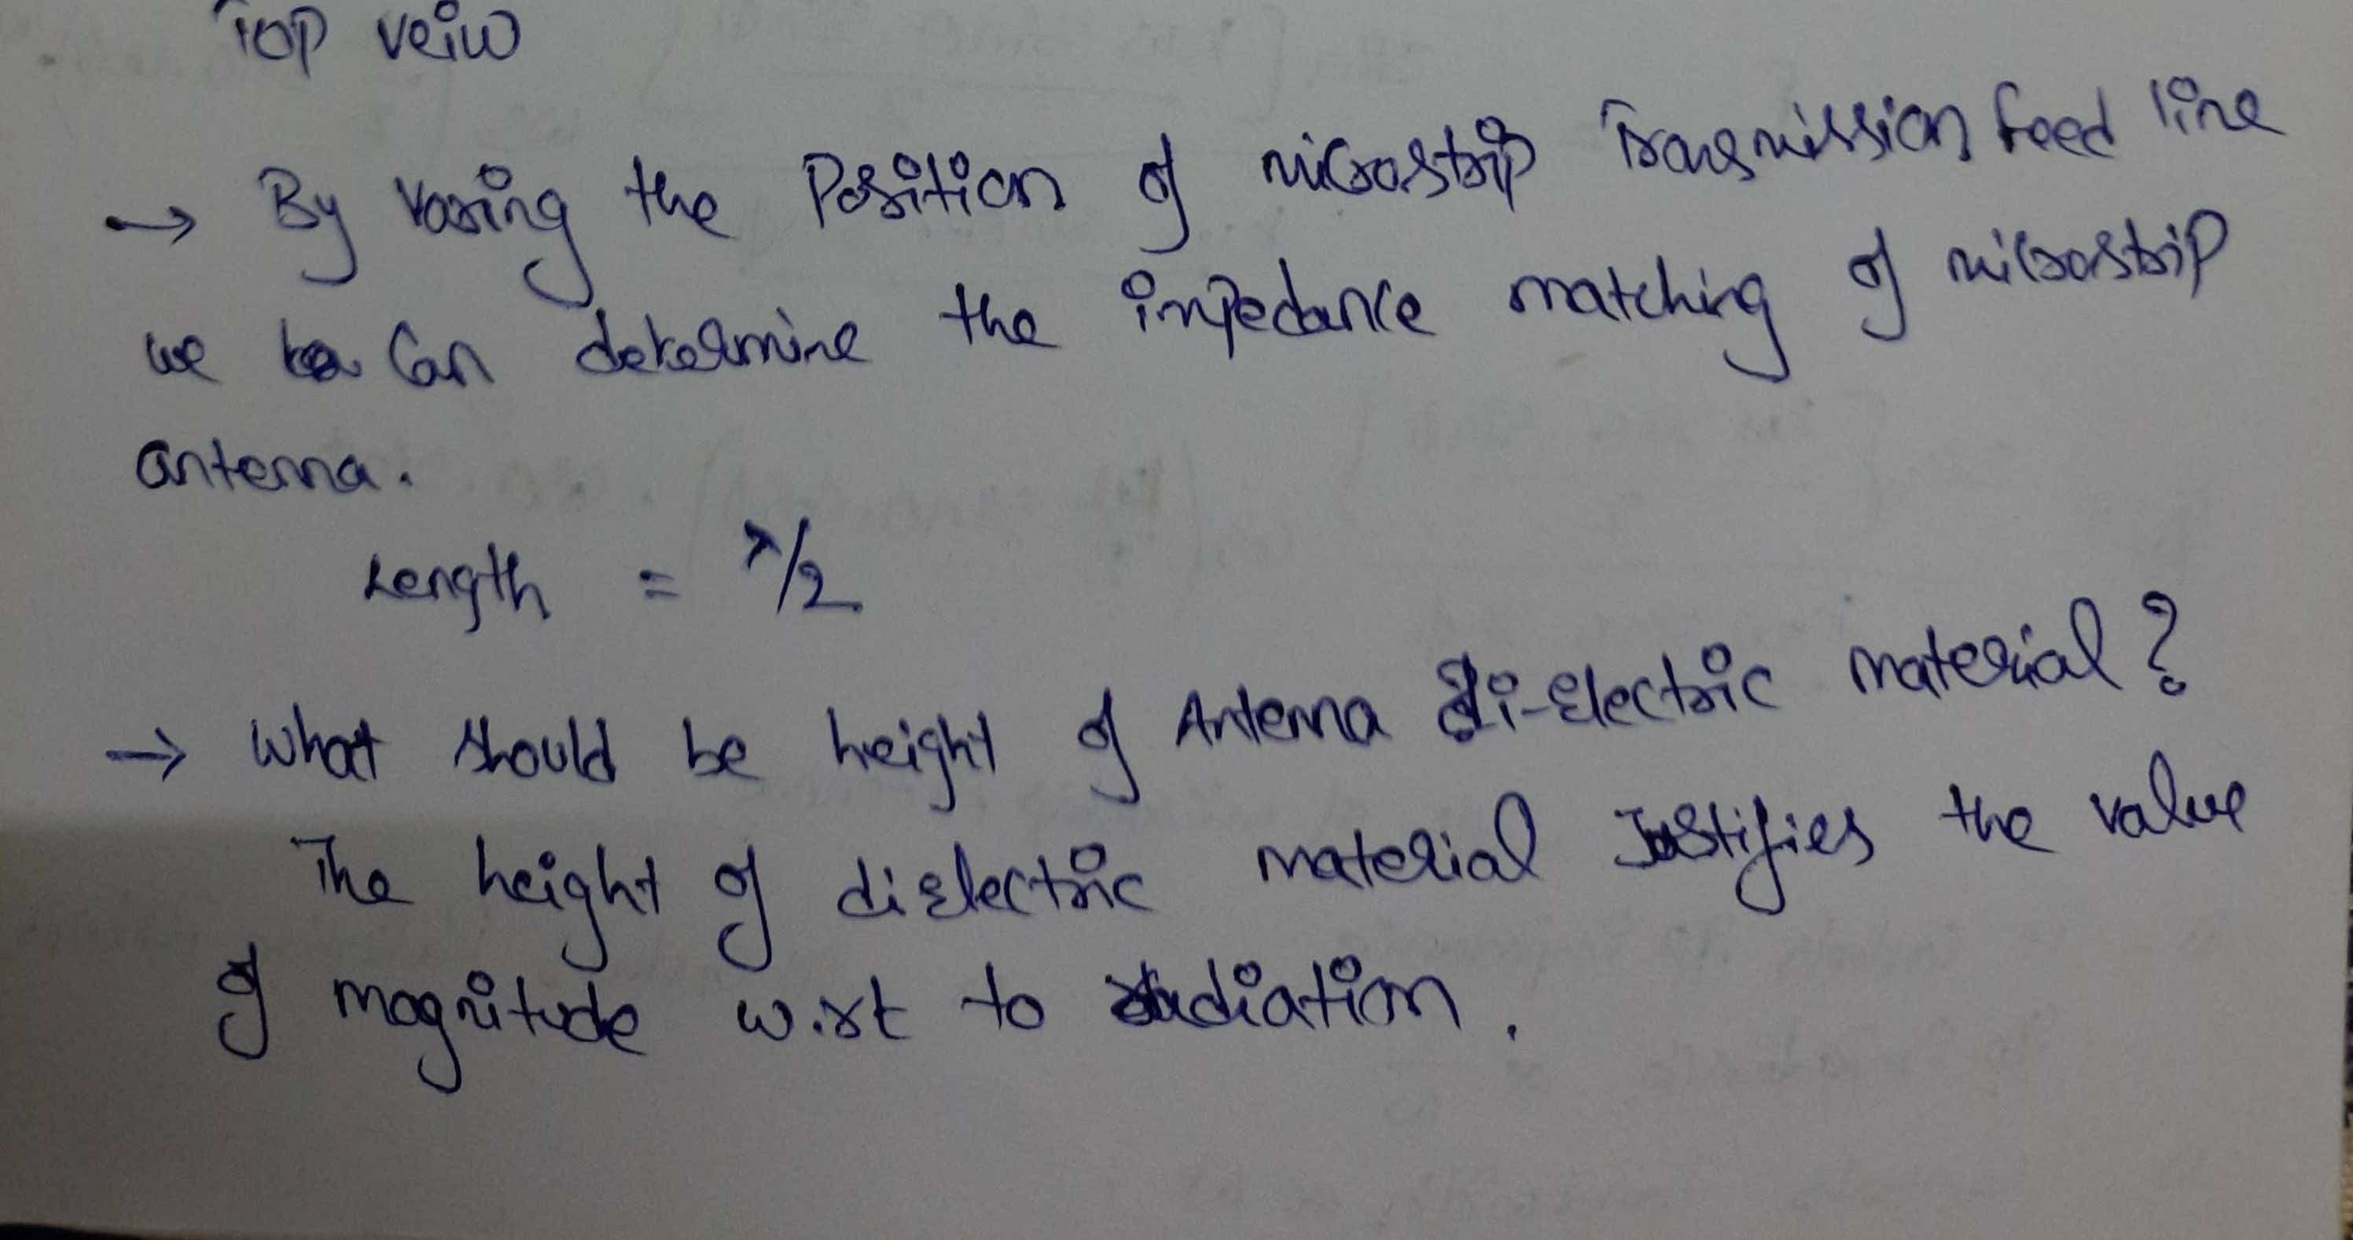

Slide 38
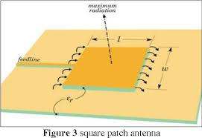
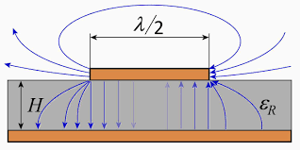

Slide 39
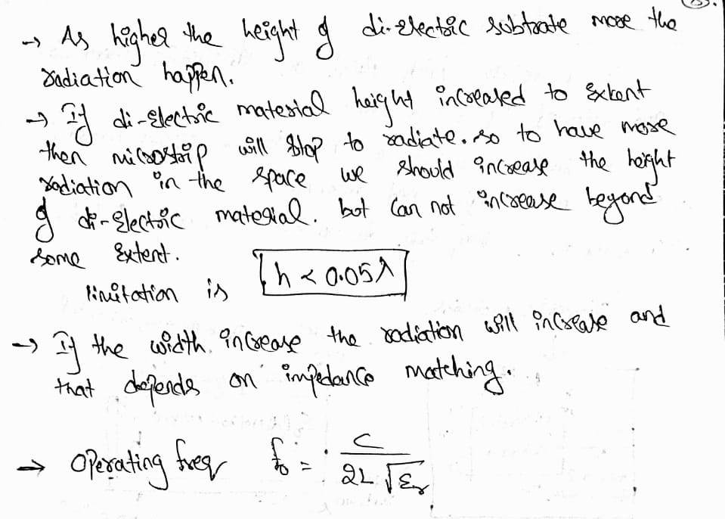

Slide 40
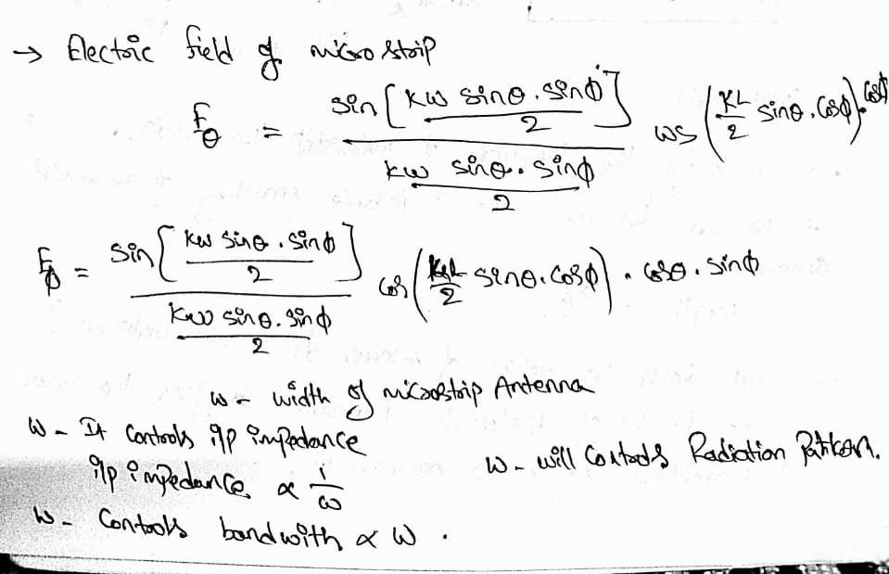

Slide 41
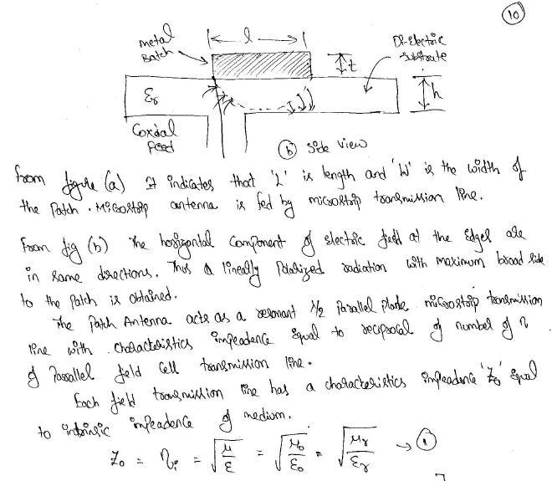

Slide 42
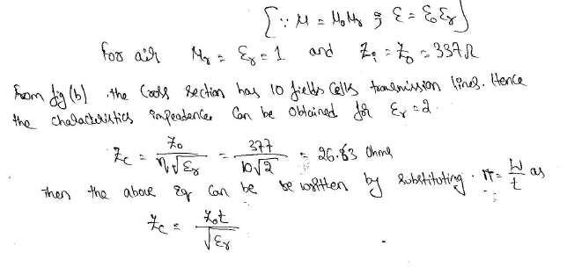

Slide 43
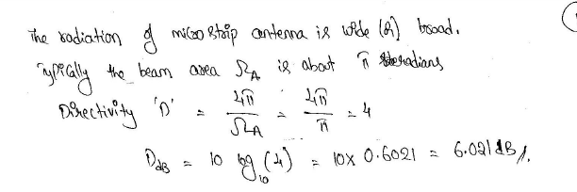

Slide 44
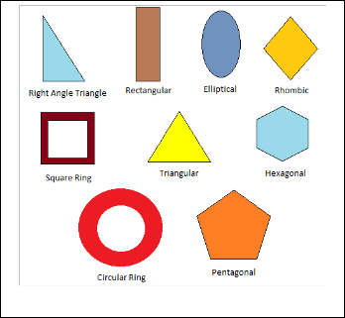
SHAPES OF THE MICROSTRIP PATCH
Different shapes of the microstrip patch gives us the different output parameters.

Slide 45
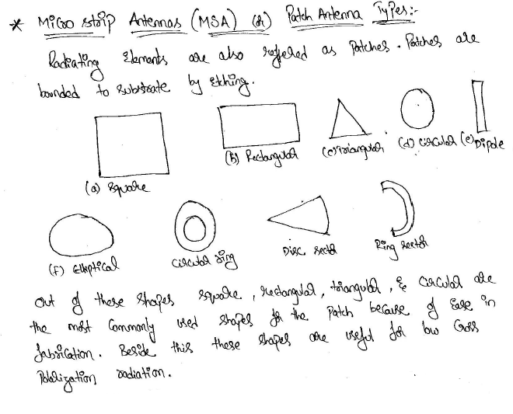
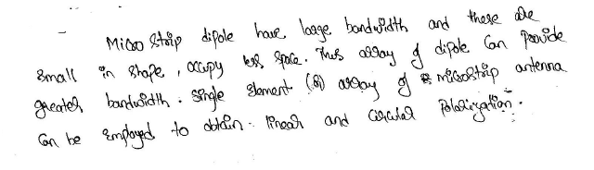

Slide 46
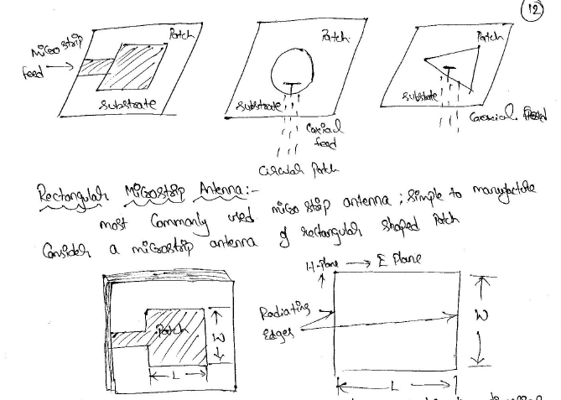

Slide 47
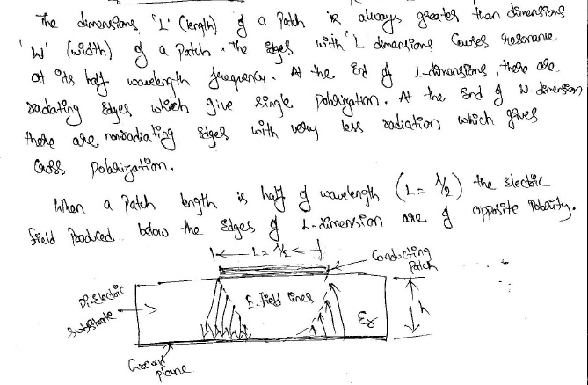

Slide 48


Slide 49


Slide 50


Slide 51
FEEDING TECHNIQUES
Feeding techniques are classified in two categories.
The one is contacting and the other is non-contacting.
There are four types of the feeding techniques
i) Coaxial probe,
ii) Microstrip line,
iii) Aperture coupled and
iv) Proximity coupled.

Slide 52


It is a feeding technique, in which the microstrip patch is directly connected with the conducting microstrip feed line. The dimensions of the feed line are different than microstrip patch. It is easy to fabricate and match.

Slide 53


Slide 54

Co-axial Probe Fed
In this feeding method, inner conductor of coaxial cable is connected to the microstrip patch of an antenna and outer one is connected with ground plane.

Slide 55


Slide 56


Slide 57


Aperture coupled Feed
This feed is having two substrates, which are different from each other and are separated by a ground plane. In this method, the microstrip patch and feed line are coupled through a slot in the ground plane. Minimization in interference and pure polarization are the advantages of aperture coupled feeding method.

Slide 58


Slide 59

Proximity Couple Feed
The fabrication of this feeding method is bit complicated comparatively. Two dielectric substrates are used in this technique. The microstrip patch is there at the upper surface of the upper dielectric substrate and the feed line is there between two substrates. It provides highest bandwidth and avoids spurious radiation.

Slide 60


Slide 61


Slide 62


Slide 63


Slide 64


Slide 65


Slide 66


Slide 67


Slide 68


Slide 69


Slide 70


Slide 71


Slide 72


Slide 73


Slide 74


Slide 75


Slide 76


Slide 77


Slide 78


Slide 79


Slide 80


Slide 81


Slide 82


Slide 83





Slide 84


Slide 85


Slide 86


Slide 87


Slide 88


Slide 89


Slide 90


Slide 91


Slide 92


Slide 93


Slide 94


Slide 95


Slide 96
Introduction
• A Parabolic Antenna is an antenna that uses a parabolic reflector, a curved surface with the cross-sectional shape of parabola, to direct the radio waves.
• It is often referred to as a Dish Antenna.
• It was invented by German physicist Heinrich Herz during his discovery of radio waves in 1887.
• It functions similarly to a searchlight or flashlight reflector to direct the radio waves in a narrow beam, or receive radio waves from one particular direction only.

Slide 97

Working
The operating principle of a parabolic antenna is that a point source of radio waves at the focal point in front of a paraboloidal reflector of conductive material will be reflected into a collimated plane wave beam along the axis of the reflector.
Conversely, an incoming plane wave parallel to the axis will be focused to a point at the focal point.

Slide 98
A typical parabolic antenna consists of a metal parabolic reflector with a small feed antenna suspended in front of the reflector at its focus, pointed back toward the reflector.
The reflector is a metallic surface formed into a paraboloid of revolution and usually truncated in a circular rim that forms the diameter of the antenna.
In a transmitting antenna, radio frequency current from a transmitter is supplied through a transmission line cable to the feed antenna, which converts it into radio waves.

Slide 99

The radio waves are emitted back toward the dish by the feed antenna and reflect off the dish into a parallel beam.
In a receiving antenna the incoming radio waves bounce off the dish and are focused to a point at the feed antenna, which converts them to electric currents which travel through a transmission line to the radio receiver.

Slide 100


Slide 101


Slide 102


Slide 103


Slide 104


Slide 105


Slide 106


Slide 107


Slide 108


Slide 109


Slide 110


Slide 111


Slide 112


Slide 113


Slide 114


Slide 115


Slide 116


Slide 117


Slide 118


Slide 119


Slide 120


Slide 121


Slide 122


Slide 123


Slide 124


Slide 125


Slide 126


Slide 127


Slide 128


Slide 129


Slide 130


Slide 131


Slide 132


Slide 133


Slide 134


Slide 135


